Slide 1
LCCC Computer Science
Laramie County community college
Exception handling

Slide 2
Learning Goals/Objectives
Be able to read, comprehend, trace, adapt and create Python code that:
  Catches general exceptions
  Catches value exceptions
  Outputs suitable error messages

Slide 3
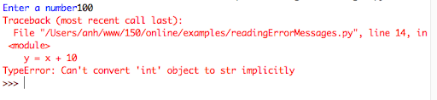
What Is An Exception?
An exception is something that happens during a program’s run that disrupts the flow of instructions.
They usually produce error messages - these are generated by an exception handler.
It’s possible to code our own exception handlers to prevent the program crashing in certain circumstances.

Slide 4
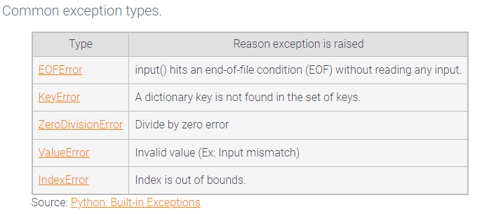
Exceptions have types – like int and string

Slide 5
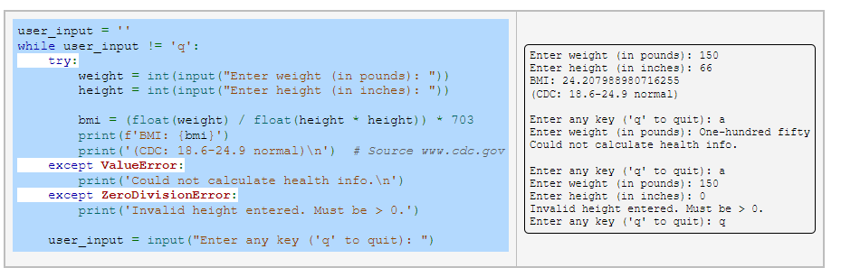
Each exception type can have its own except test

Slide 6
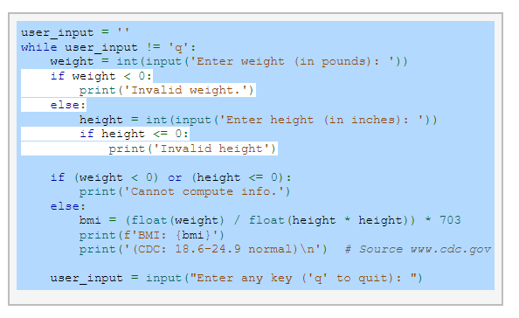
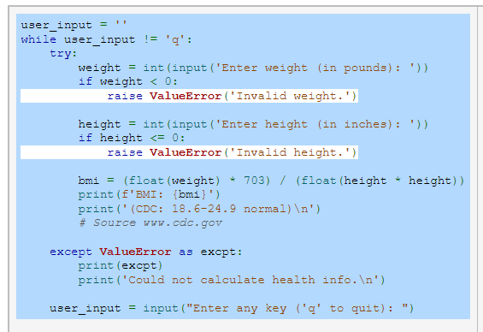
Raising Exceptions
You can handles a lot of cases with raising errors and using just the one valueError
Except block to deal with them all! (And a lot less if then else work!)*

Slide 7
Basic Exception Handling

Slide 8
Exceptions - How To Code
try:
Run this code in normal circumstances
except:
Run this code when there is an exception

Slide 9
Exceptions - How To Code
name = “Dave”
try:
print(name)
except:
print(“The variable has not been assigned”)
Notes:
This code will handle exceptions for variables that have not been defined.
In this example, the code will print the ‘name’ variable, as it has been assigned before the print line has been used.

Slide 10
Exceptions - How To Code
try:
print(name)
except:
print(“The variable has not been assigned”)
Notes:
This code will handle exceptions for variables that have not been defined.
In this example, the code will catch the error (name has not been initialised before trying to use it in the print command) and will print the error message instead

Slide 11
Exceptions - How To Code
try:
print(name)
except NameError:
print(“The variable has not been assigned”)
except:
print(“Something else went wrong)
Notes:
This type of error is called a NameError - we can get our except code to look out for it specifically. A NameError means that Python tried to use a variable or function name, such as hello based on a previous definition. If it hasn't been defined at this point, you get the error. Usual Causes: A mistyped variable or function name.
Then we can add another exception to catch any other type of error.

Slide 12
Exceptions - How To Code
try:
print(name)
except NameError:
print(“The variable has not been assigned”)
except:
print(“Something else went wrong)
else:
print(“nothing went wrong”)
Notes:
The else will run if no errors are raised

Slide 13
Exceptions - How To Code
try:
print(name)
except NameError:
print(“The variable has not been assigned”)
except:
print(“Something else went wrong)
else:
print(“Nothing went wrong”)
finally:
print(“The try except has finished”)
Notes:
The finally will always run, regardless of whether there has been an error or not.

